Slide 3
Pianissimo

Slide 5
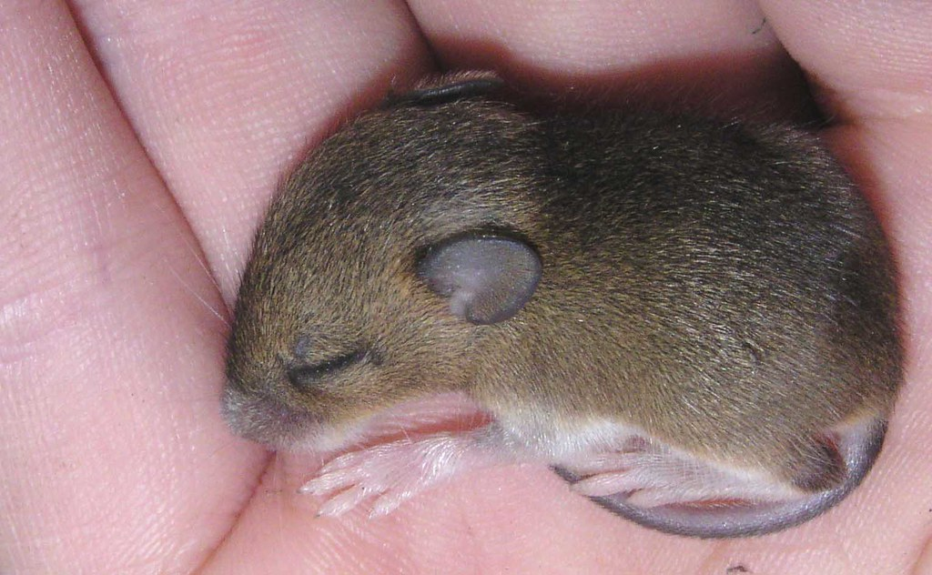
Piano

Slide 8
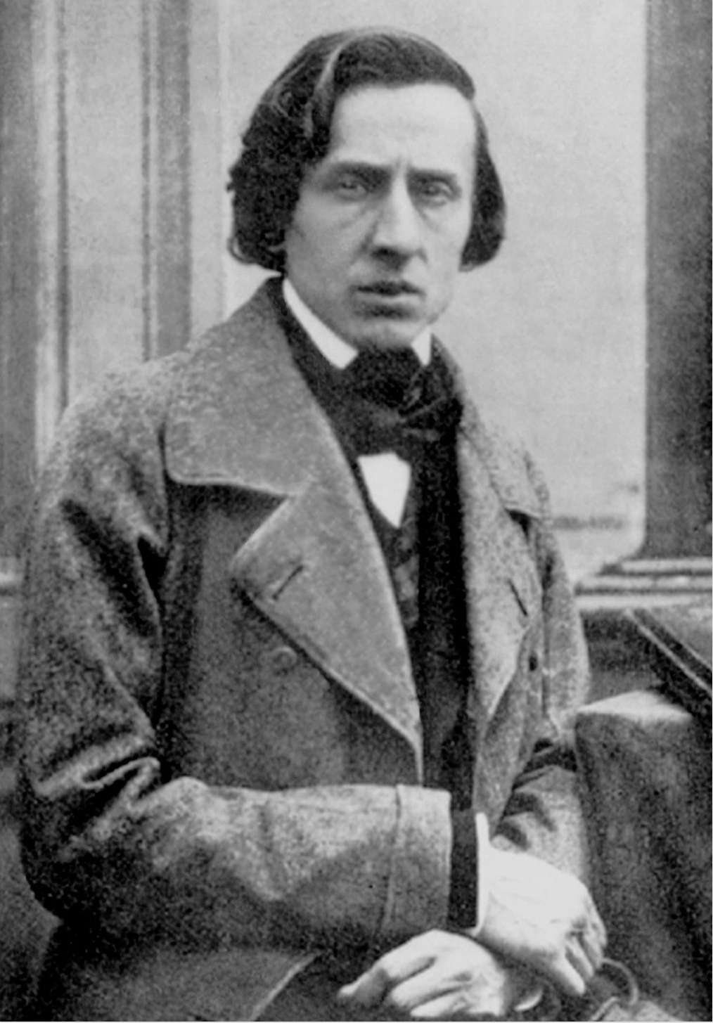
Chopin Prelude 20
www.youtube.com/watch?v=7zQYuhR-TUQ

Slide 9
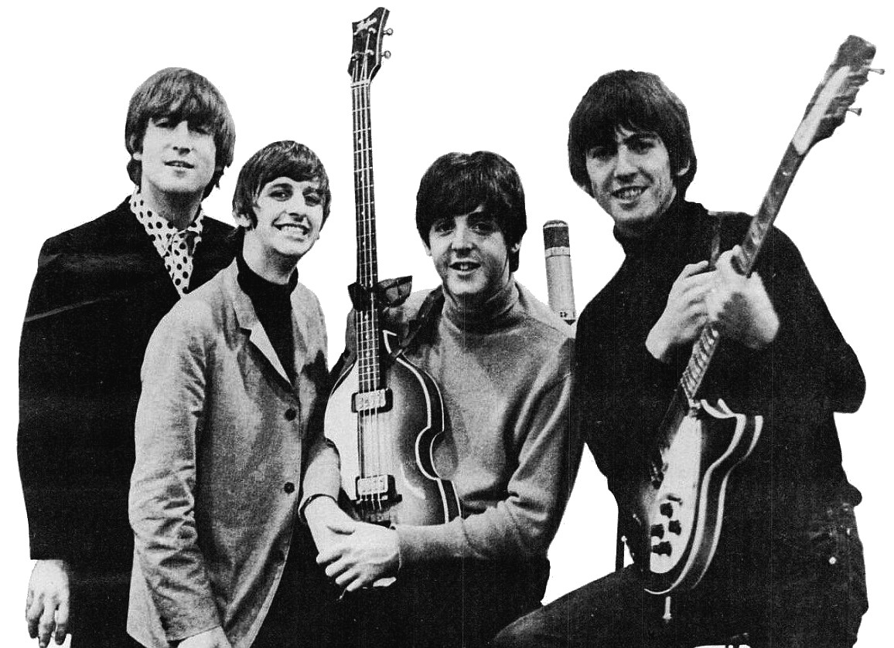
The Beatles
https://www.youtube.com/watch?v=TZip_br_v3w&list=PLlCi2fGo0CiKCtJuVGgmSg6d7ANgc6RdR&index=22&safe=active

Slide 10
Nirvana Something in the way
https://www.bing.com/videos/search?q=YouTube+Nirvana+Something+in+the+Way&&view=detail&mid=F42E57481B22A195606CF42E57481B22A195606C&&FORM=VRDGAR&ru=%2Fvideos%2Fsearch%3Fq%3DYouTube%2BNirvana%2BSomething%2Bin%2Bthe%2BWay%26FORM%3DVDMHRS

Slide 12
https://www.bing.com/videos/search?q=stan+and+mabel+and+the+race+for+space&view=detail&mid=993AE3AE5A34C9056656993AE3AE5A34C9056656&FORM=VIRE&adlt=strict
Polly Ives

Slide 15
www.youtube.com/watch?v=7zQYuhR-TUQ Chopin
www.youtube.com/watch?v=52-EkZRnG2E
Barry Manilow

Slide 16
Mezzo Forte (Moderately loud)

Slide 17
www.youtube.com/watch?v=HXH6Gf6YhJQ
Take That

Slide 18
Forte

Slide 19
https://www.youtube.com/watch?v=lUYEvCly8Fo

Slide 20
Fortissimo

Slide 21
https://www.youtube.com/watch?v=htobTBlCvUU&safe=active

